Slide 1

Drama At Cornwallis Academy
Year 7 – LESSON 4
Lesson Objective:
To investigate the use of Narration.
To understand how to use Narration within a performance.

Slide 2
Level | Drama Strand
 | Creating | Performing | Reflecting
Entry | I can take part in a drama activity | I can participate in part of a group performance | I can identify positive and negative aspects within my work
1 | I can take part in a range of drama activities I can explore problems in an imagined world and make up plays from stories or other stimuli | I can participate in a short group performance I show some consideration of movement and voice in performance | I can make simple connections between the dramas I experience and my own life I can recognise when my own work and the work of others’, could be improved
2 | I can perform my own simple scenes, demonstrating an understanding of drama techniques | I can use my voice and body to create a simple character I can act out improvised dramas | I can talk about why I made certain decisions in my play I can show a basic understanding of how meaning can be shown
3 | I can establish a character with control over movement and voice I can use the dialogue in existing texts as well as creating my own I can devise plays from a range of stimuli I can respond to the use of drama techniques to deepen the role or understanding of the situation e.g. hot seating I can sustain a defined character for a reasonable amount of time | I can learn lines and organise simple performances | I can give suggestions on how work could be improved I can talk about my work using some technical drama terminology I can discuss and give reasons for my preferences in the drama I have seen

Slide 3
WHAT IS NARRATION?
Lesson Objective:
To investigate the use of Narration.
To understand how to use Narration within a performance.
Narrating is what you do when you're giving a spoken commentary on the action taking place during a drama.
It's a useful technique when you want to inform the audience of what is happening.

Slide 4
Why use narrating? What can it add to a drama?
Lesson Objective:
To investigate the use of Narration.
To understand how to use Narration within a performance.
Narrating can make a drama more understandable or stylised in a number of ways:
an actor can speak the commentary over the action happening in the drama.
a character can speak out what s/he thinks the audience needs to know about the characters or the situation of which s/he is a part - this is called self-narrating.
an actor can just tell the audience what they need to know in between scenes.
a character can read or write a diary or letter that informs the audience what is important for them to know about what is happening or going to happen.

Slide 5
BREAKFAST PRACTICE
Lesson Objective:
To investigate the use of Narration.
To understand how to use Narration within a performance.
In groups of three we will practice a variety of Narration Skills.
1) Narrator introduces the scene of two people having breakfast – the two actors then act the scene out without words.
Three characters are in the breakfast scene, one of the characters narrates through the scene.
Actor writes diary entry before parents come in for breakfast.

Slide 6
MODEL
Lesson Objective:
To investigate the use of Narration.
To understand how to use Narration within a performance.
Teacher will model effective Narration.

Slide 7
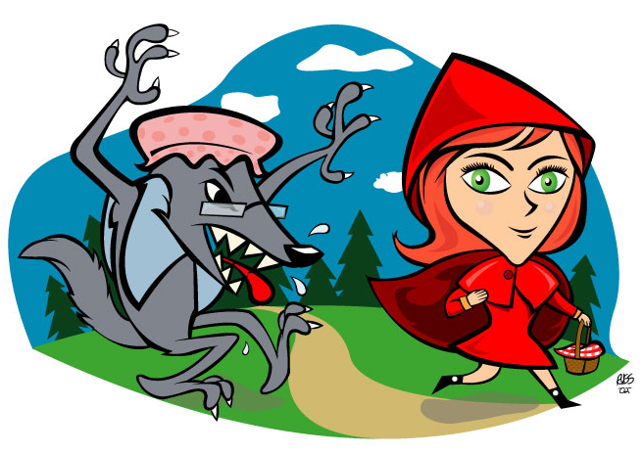
LITTLE RED RIDING HOOD
Lesson Objective:
To investigate the use of Narration.
To understand how to use Narration within a performance.
Re-cap the story of Little Red Riding Hood in your groups.

Slide 8
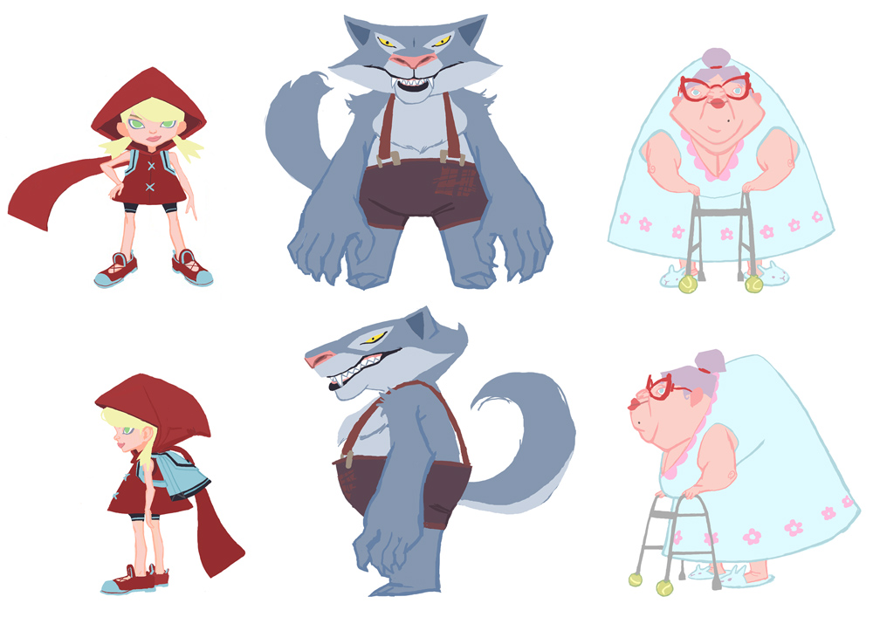
LITTLE RED RIDING HOOD – THROUGH THE EYES OF...
Lesson Objective:
To investigate the use of Narration.
To understand how to use Narration within a performance.
Each group will tell the story of Little Red Riding Hood and use Narration throughout.
REMEMBER
Narrator must speak clearly and direct it to audience.
There are different styles of Narration
Narration should add information or move the story forward.

Slide 9
REMEMBER
Lesson Objective:
To investigate the use of Narration.
To understand how to use Narration within a performance.
Narrator must speak clearly and direct it to audience.
Narrator could speak in verse or accent.
There are different styles of Narration
Narration should add information or move the story forward.

Slide 10
STOP AND SHOW
Lesson Objective:
To investigate the use of Narration.
To understand how to use Narration within a performance.
Teacher will stop you at a random moment and check progress…
Teacher may spotlight a group…
So stay on a task!

Slide 11
SPOTLIGHTING
Lesson Objective:
To investigate the use of Narration.
To understand how to use Narration within a performance.
Spotlight all groups and observe their work.
WWW – What Went Well?
What worked and why?
What could be improved? And why?

Slide 12
Lesson Objective:
To investigate the use of Narration.
To understand how to use Narration within a performance.
Summing up:
What have you learnt today?
What level have you achieve and how/ why?
What do you need to do to meet your target grade?
Get into a pair.
Share your knowledge and ideas with your partner

